Slide 1
Amazon Elastic Compute Cloud (Amazon EC2) and Amazon Elastic Block Store (Amazon EBS)
Dr. Noman Islam

Slide 2
Amazon EC2
Amazon EC2 is AWS primary web service that provides resizable compute capacity in the cloud

Slide 3
Compute basics
Compute refers to the amount of computational power required to fulfill your workload.
Amazon EC2 allows you to acquire compute through the launching of virtual servers called instances.
Because you are paying for the computing power of the instance, you are charged per hour while the instance is running

Slide 4
Instance Types
The instance type defines the virtual hardware supporting an Amazon EC2 instance. There are dozens of instance types available, varying in the following dimensions:
Virtual CPUs (vCPUs)
Memory Storage (size and type)
Network performance
Instance types are grouped into families based on the ratio of these values to each other.

Slide 5
For instance, the m4 family provides a balance of compute, memory, and network resources, and it is a good choice for many applications.
Within each family there are several choices that scale up linearly in size

Slide 6
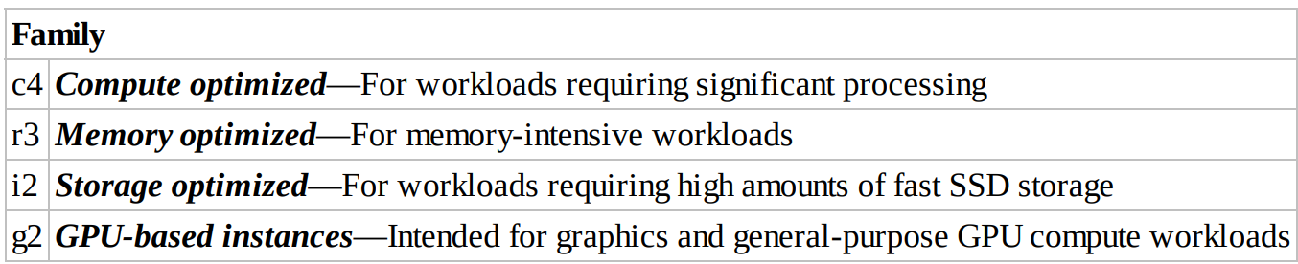

Slide 7
Network performance
Another variable to consider when choosing an instance type is network performance.
For most instance types, AWS publishes a relative measure of network performance: low, moderate, or high.
For workloads requiring greater network performance, many instance types support enhanced networking.

Slide 8
Enhanced networking reduces the impact of virtualization on network performance by enabling a capability called Single Root I/O Virtualization (SR-IOV).
This results in more Packets Per Second (PPS), lower latency, and less jitter
There are instance types that support enhanced networking in the C3, C4, D2, I2, M4, and R3 families

Slide 9
Amazon Machine Images
The Amazon Machine Image (AMI) defines the initial software that will be on an instance when it is launched.
An AMI defines every aspect of the software state at instance launch, including:
The Operating System (OS) and its configuration
The initial state of any patches
Application or system software

Slide 10
Sources of AMIs
Published by AWS
The AWS Marketplace
Generated from Existing Instances
Uploaded Virtual Servers

Slide 11
Addressing an instance
Public Domain Name System (DNS) Name—When you launch an instance, AWS creates a DNS name that can be used to access the instance
The name can be found in the Description tab of the AWS Management Console or via the Command Line Interface (CLI) or Application Programming Interface (API).
This DNS name persists only while the instance is running and cannot be transferred to another instance

Slide 12
Public IP
A launched instance may also have a public IP address assigned.
This IP address is assigned from the addresses reserved by AWS and cannot be specified.

Slide 13
Elastic IP
An elastic IP address is an address unique on the Internet that you reserve independently and associate with an Amazon EC2 instance.
This IP address persists until the customer releases it and is not tied to the lifetime or state of an individual instance
Because it can be transferred to a replacement instance in the event of an instance failure, it is a public address that can be shared externally without coupling clients to a particular instance.

Slide 14
Initial Access
Amazon EC2 uses public-key cryptography to encrypt and decrypt login information.
Public-key cryptography uses a public key to encrypt a piece of data and an associated private key to decrypt the data.
These two keys together are called a key pair. Key pairs can be created through the AWS Management Console, CLI, or API, or customers can upload their own key pairs.

Slide 15
AWS stores the public key, and the private key is kept by the customer.
The private key is essential to acquiring secure access to an instance for the first time.

Slide 16
Virtual Firewall protection
AWS allows you to control traffic in and out of your instances through virtual firewalls called security groups.
Security groups allow you to control traffic based on port, protocol, and source/destination
Security groups are associated with instances when they are launched. Every instance must have at least one security group but can have more

Slide 17
A security group is default deny; that is, it does not allow any traffic that is not explicitly allowed by a security group rule.
A rule is defined by the three attributes

Slide 18
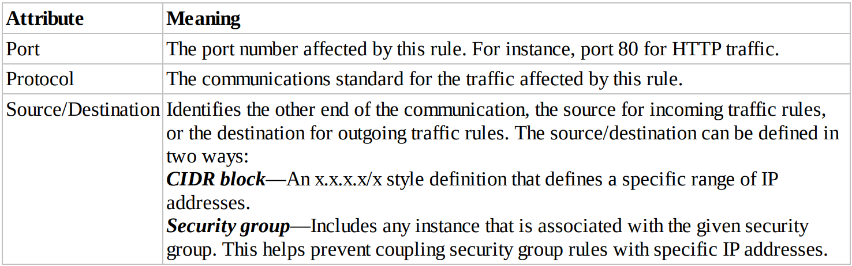

Slide 19
Bootstrapping
A great benefit of the cloud is the ability to script virtual hardware management in a manner that is not possible with on-premises hardware.
In order to realize the value of this, there has to be some way to configure instances and install applications programmatically when an instance is launched.
The process of providing code to be run on an instance at launch is called bootstrapping.
On Linux instances this can be shell script, and on Windows instances this can be a batch style script or a PowerShell script.

Slide 20
VM Import/Export
In addition to importing virtual instances as AMIs, VM Import/Export enables you to easily import Virtual Machines (VMs) from your existing environment as an Amazon EC2 instance and export them back to your on-premises environment.
You can only export previously imported Amazon EC2 instances

Slide 21
Managing instances
When the number of instances in your account starts to climb, it can become difficult to keep track of them.
Tags can help you manage not just your Amazon EC2 instances, but also many of your AWS Cloud services.
Tags are key/value pairs you can associate with your instance or other service.
Tags can be used to identify attributes of an instance like project, environment (dev, test, and so on), billable department, and so forth.
You can apply up to 10 tags per instance

Slide 22
Monitoring instances
AWS offers a service called Amazon CloudWatch that provides monitoring and alerting for Amazon EC2 instances, and also other AWS infrastructure.

Slide 23
Modifying an instance
Instance Type The ability to change the instance type of an instance contributes greatly to the agility of running workloads in the cloud.
Instead of committing to a certain hardware configuration months before a workload is launched, the workload can be launched using a best estimate for the instance type.
If the compute needs prove to be higher or lower than expected, the instances can be changed to a different size more appropriate to the workload

Slide 24
Security group
If an instance is running in an Amazon VPC, you can change which security groups are associated with an instance while the instance is running.
For instances outside of an Amazon VPC (called EC2-Classic), the association of the security groups cannot be changed after launch.

Slide 25
Termination protection
When an Amazon EC2 instance is no longer needed, the state can be set to Terminated and the instance will be shut down and removed from the AWS infrastructure.
In order to prevent termination via the AWS Management Console, CLI, or API, termination protection can be enabled for an instance.

Slide 26
Pricing options
You are charged for Amazon EC2 instances for each hour that they are in a running state, but the amount you are charged per hour can vary based on three pricing options:
On-Demand Instances,
Reserved Instances,
and Spot Instances.

Slide 27
On-demand instance
The price per hour for each instance type published on the AWS website represents the price for On-Demand Instances.
This is the most flexible pricing option, as it requires no up-front commitment, and the customer has control over when the instance is launched and when it is terminated.
It is the least cost effective of the three pricing options per compute hour, but its flexibility allows customers to save by provisioning a variable level of compute for unpredictable workloads.

Slide 28
Reserved instances
The Reserved Instance pricing option enables customers to make capacity reservations for predictable workloads.
By using Reserved Instances for these workloads, customers can save up to 75 percent over the on-demand hourly rate.
When purchasing a reservation, the customer specifies the instance type and Availability Zone for that Reserved Instance and achieves a lower effective hourly price for that instance for the duration of the reservation

Slide 29
Payment options
All Upfront
Partial Upfront
No Upfront

Slide 30
Spot instances
With Spot Instances, customers specify the price they are willing to pay for a certain instance type.
When the customer’s bid price is above the current Spot price, the customer will receive the requested instance(s).
These instances will operate like all other Amazon EC2 instances, and the customer will only pay the Spot price for the hours that instance(s) run

Slide 31
Instance stores
An instance store (sometimes referred to as ephemeral storage) provides temporary block-level storage for your instance.
This storage is located on disks that are physically attached to the host computer
While some provide Hard Disk Drive (HDD) instance stores, other instance types use Solid State Drives (SSDs) to deliver very high random I/O performance

Slide 32
Data in the instance store is lost when:
The underlying disk drive fails.
The instance stops (the data will persist if an instance reboots).
The instance terminates.
Therefore, do not rely on instance stores for valuable, long-term data. Instead, build a degree of redundancy via RAID or use a file system that supports redundancy and fault tolerance such as Hadoop’s HDFS.
Back up the data to more durable data storage solutions such as Amazon Simple Storage Service (Amazon S3) or Amazon EBS often enough to meet recovery point objectives.

Slide 33
Amazon Elastic Block Store (Amazon EBS)
Amazon EBS provides persistent block-level storage volumes for use with Amazon EC2 instances.
Each Amazon EBS volume is automatically replicated within its Availability Zone to protect you from component failure, offering high availability and durability.
Amazon EBS volumes are available in a variety of types that differ in performance characteristics and price.
Multiple Amazon EBS volumes can be attached to a single Amazon EC2 instance, although a volume can only be attached to a single instance at a time.

Slide 34
Types of volumes
Amazon EBS volumes are available in several different types.
Types vary in areas such as underlying hardware, performance, and cost. It is important to know the properties of the different types

Slide 35
Magnetic volume
Magnetic volumes have the lowest performance characteristics of all Amazon EBS volume types.
As such, they cost the lowest per gigabyte. They are an excellent, cost-effective solution for appropriate workloads.
A magnetic Amazon EBS volume can range in size from 1 GB to 1 TB and will average 100 IOPS, but has the ability to burst to hundreds of IOPS.

Slide 36
They are best suited for:
Workloads where data is accessed infrequently
Sequential reads
Situations where low-cost storage is a requirement
Magnetic volumes are billed based on the amount of data space provisioned, regardless of how much data you actually store on the volume

Slide 37
General-Purpose SSD
General-purpose SSD volumes offer cost-effective storage that is ideal for a broad range of workloads.
They deliver strong performance at a moderate price point that is suitable for a wide range of workloads.
A general-purpose SSD volume can range in size from 1 GB to 16 TB and provides a baseline performance of three IOPS per gigabyte provisioned, capping at 10,000 IOPS.

Slide 38
They are suited for a wide range of workloads where the very highest disk performance is not critical, such as:
System boot volumes
Small- to medium-sized databases
Development and test environment

Slide 39
Provisioned IOPS SSD
Provisioned IOPS SSD volumes are designed to meet the needs of I/O-intensive workloads, particularly database workloads that are sensitive to storage performance and consistency in random access I/O throughput.
While they are the most expensive Amazon EBS volume type per gigabyte, they provide the highest performance of any Amazon EBS volume type in a predictable manner
When you provision a Provisioned IOPS SSD volume, you specify not just the size, but also the desired number of IOPS, up to the lower of the maximum of 30 times the number of GB of the volume, or 20,000 IOPS.

Slide 40
Pricing is based on the size of the volume and the amount of IOPS reserved.
Provisioned IOPS SSD volumes provide predictable, high performance and are well suited for:
Critical business applications that require sustained IOPS performance
Large database workloads

Slide 41
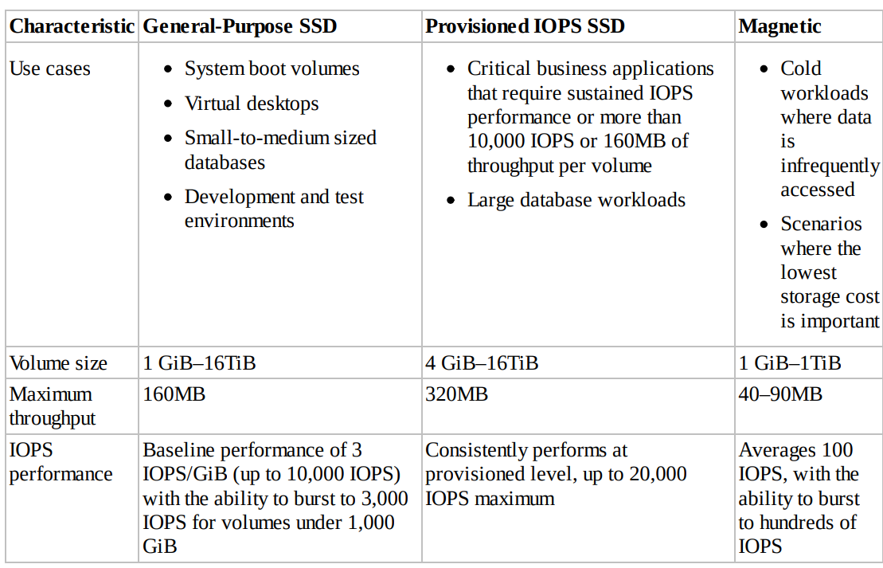

Slide 42
Protecting data
You can back up the data on your Amazon EBS volumes, regardless of volume type, by taking point-intime snapshots.
Snapshots are incremental backups, which means that only the blocks on the device that have changed since your most recent snapshot are saved.
You can take snapshots in many ways:
Through the AWS Management Console
Through the CLI Through the API
By setting up a schedule of regular snapshots

Slide 43
Data for the snapshot is stored using Amazon S3 technology
It’s important to know that while snapshots are stored using Amazon S3 technology, they are stored in AWS-controlled storage and not in your account’s Amazon S3 buckets.

Slide 44
Recovering volumes
Because Amazon EBS volumes persist beyond the lifetime of an instance, it is possible to recover data if an instance fails. I
f an Amazon EBS-backed instance fails and there is data on the boot drive, it is relatively straightforward to detach the volume from the instance.
Unless the DeleteOnTermination flag for the volume has been set to false, the volume should be detached before the instance is terminated.
The volume can then be attached as a data volume to another instance and the data read and recovered.

Slide 45
Conclusion
Compute is the amount of computational power required to fulfill your workload.
Amazon EC2 is the primary service for providing compute to customers.
The instance type defines the virtual hardware supporting the instance
An AMI defines the initial software state of the instance, both OS and applications.
Instances can be addressed by public DNS name, public IP address, or elastic IP address

